Slide 1
SSAC Meeting
February 21 , 2024

Slide 2
Meeting Agenda
Welcome
Call to order
Roll Call
Consideration of November 15, 2023 Minutes
Elections of Chair and Vice Chair
Updates from PSC – Director Sankey
Regionalization
NG911 Deployment Status
OSP Migration
911 Outage Investigation Update
Working Group Updates
Technology
Operations
Training
New Business
Volunteer Fire Department Radio Program
Legislation
MIS contract
Committee Appointments
Next SSAC Meeting
Notes:
Update with new agenda

Slide 3
Old Business: PSC Updates

Slide 5
NG911 Project Deployment
Task Name | Scheduled Start | Projected Finish
East Central Region | April 2024 | May 2024
Southeast Region | Done except for Lincoln | Mid-March 2024

Slide 6
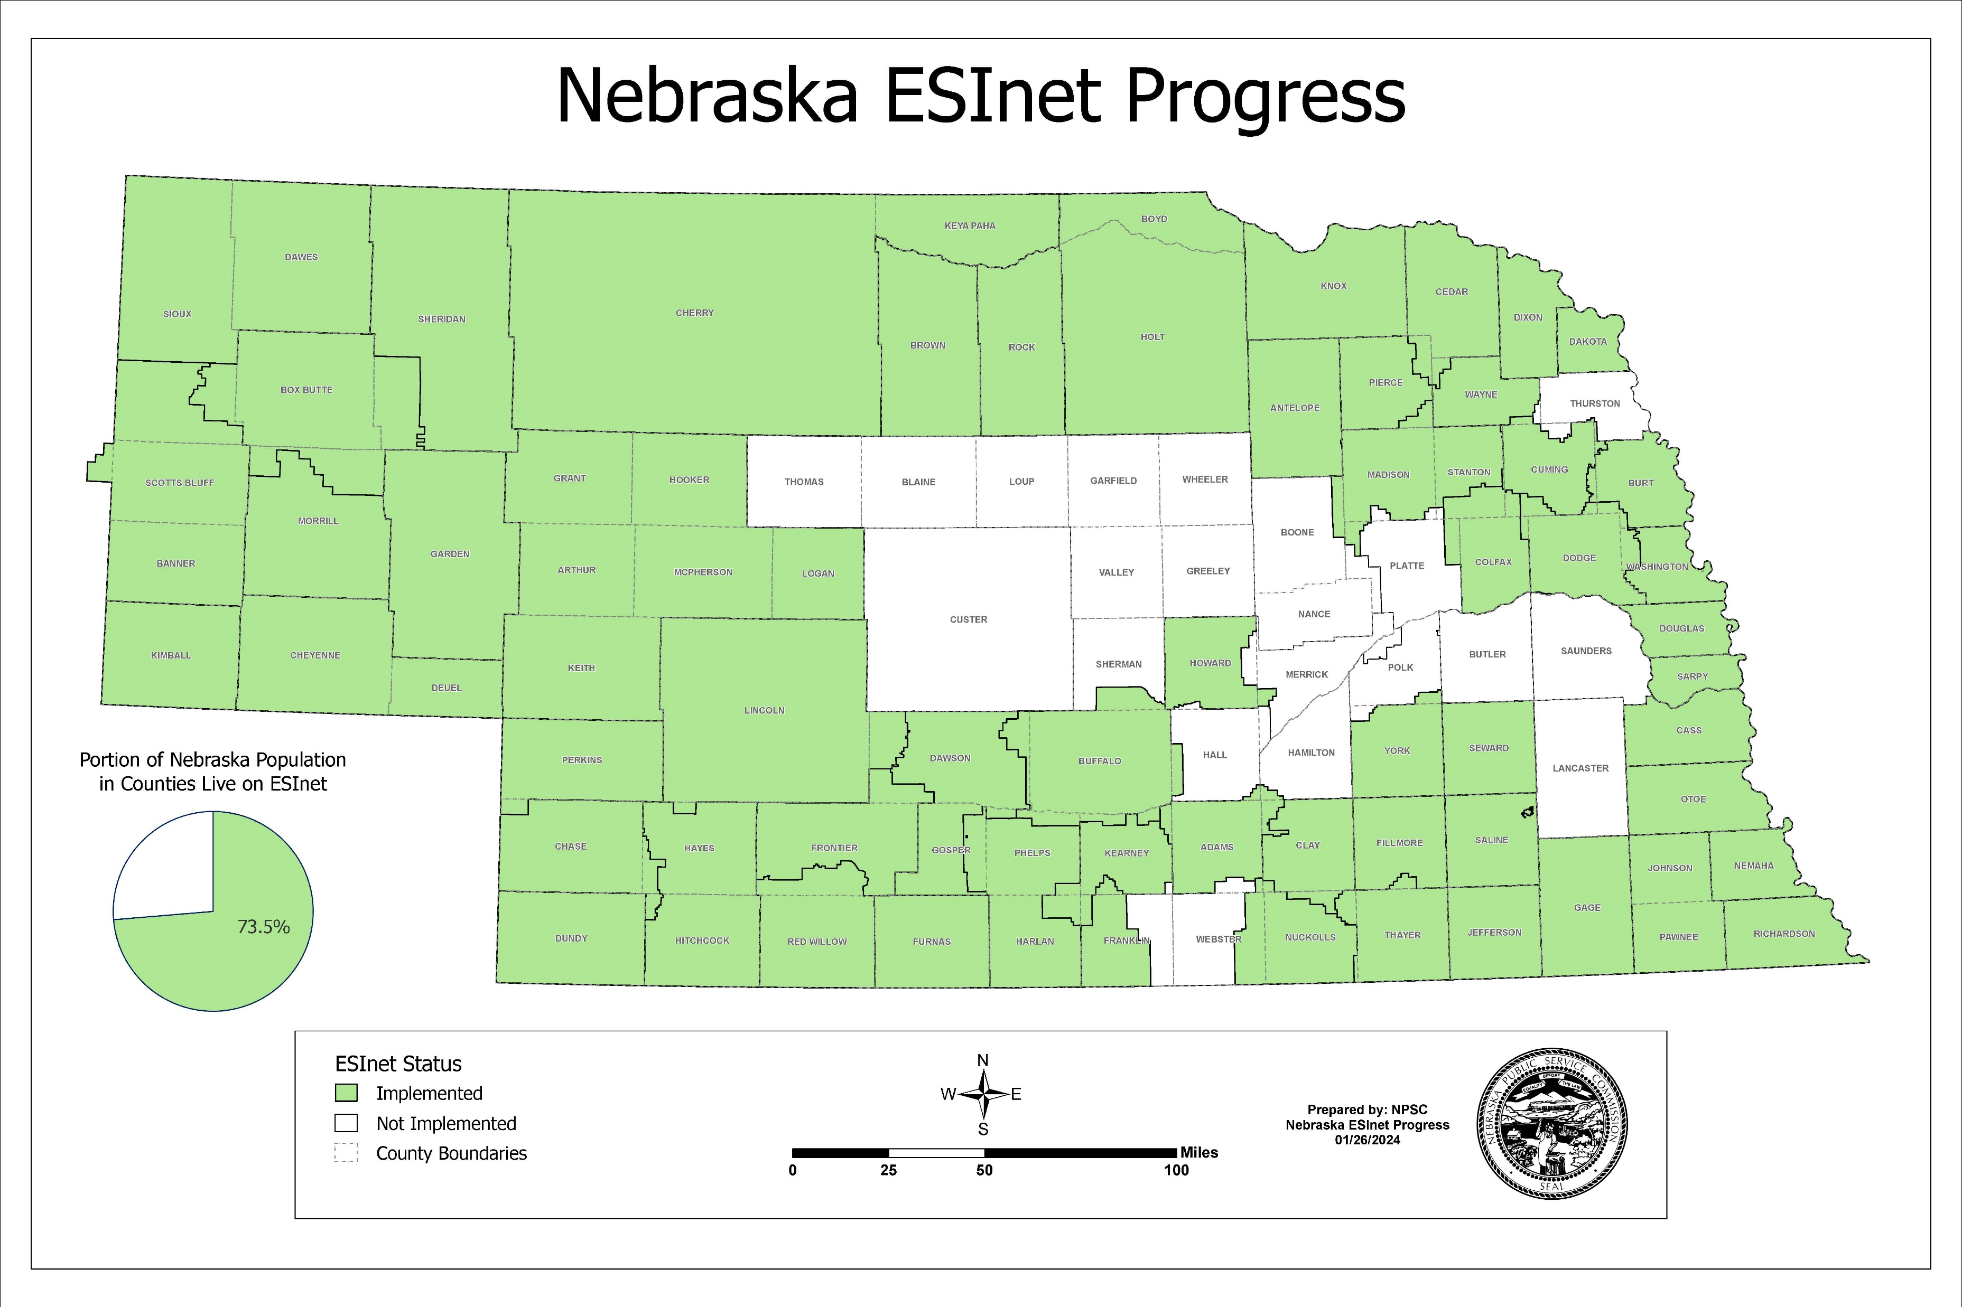

Slide 7
Notes:
Updated

Slide 8
Working Group Updates

Slide 9
Technology Working Group
Vision: No call goes unanswered
Backup networking capabilities
Improve Outage Notification Process
Operations working group developed 9-1-1 Telephone Outage Issue/Checklist and associated policy
Examine Carrier Diversity
Provider of regional ESInet should be different than provider of admin lines and internet
Notes:
Tech Working Group:
The Technology and Operations working groups met October 2nd to discuss the recent Windstream and Lumen outages and are aligned to develop model policies related to outage notifications that include steps PSAPs can take when affected by an outage.
Operations taking the lead on outage notification checklist/policy.
Provider of regional ESInet should be different than provider of admin lines and internet.

Slide 10
Operations Working Group
Vision: Collaborating with the Nebraska PSAP community to create model operational policy for the purpose of ensuring the delivery of quality 911 service to consumers statewide. Including a focus on best practices; consistency; quality; and operationally focused technology deployments
Improve Communications in an Outage
911 Telephone Carrier Outage Checklist for PSAPs
Model Outage Communications Policy
Notes:
Outage Policy and procedure:
Joint meeting of the Technical and Operations working groups held on October 2, 2023
Operations group took the lead in creating model outage communications policy and checklist template for PSAPs—Working Group met January 5th and 24th
The working group developed a 9-1-1 Telephone Outage Checklist template that can be used by PSAPs or modified as required.

Slide 11
Training Working Group Update
Vision: To develop and implement a foundation for minimum training standards and certification for each level of PSAP employee to ensure telecommunicator’s are trained to provide a consistent level of service across the State of Nebraska.
Telecommunicator Certification
Notes:
Training working group met February 2nd.
The group discussed the value of telecommunicator certification and examined what makes up a strong certification program. Nebraska has many of the attributes of a strong program already and only needs to do a few more things to pursue it.
Dave, Depending on the outcomes of the meeting on Friday, the PPT slides could be modified to have Shelly present the findings of the team.

Slide 12
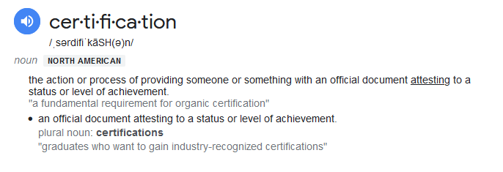
Why Certify our Telecommunicators?

Slide 13
Why Certify our Telecommunicators?
Certification benefits the telecommunicator
Certification provides these professionals the tools to do the job to the best level possible ensuring the safety of Nebraska residents and visitors
Certification aids in professionalizing the career
Notes:
Training working group met on February 6th.
MCP provided research on the requirements of a telecommunicator certification program and examples of how other states have gone about developing a certification program.
Nebraska has already completed the majority of requirements.
The Training working is taking time to consider the research MCP provided and because the TCP-R requirement just went into effect, the training working group has decided it is going to study the certification question for a while and allow the PSAPs to catch up to the training standards we have set.

Slide 14
Why Certify our Telecommunicators?
Advantages:
Ensure equity of telecommunicator training
Ensure adherence to State minimum training requirements
As minimum training requirements evolve, those updates are captured in the certification records
Could aid in areas of liability
Notes:
Would you want a LEO/FD/EMS provider that didn’t have required certifications?
Minimum training guidelines are in place to protect the profession and the public; a well-established certification is an extra level of protection to ensure that consistency of training is maintained.
911 is increasingly present in the media for investigation of circumstances when telecommunicator or PSAP performance is called into question; well maintained, accessible certification records can simplify responses to media inquiries in those cases.
Requirements: the need for tracking of submissions from state PSAPs
Liability will always be present in the 911 industry, but any steps taken to reduce that are a benefit. Certification of well developed training requirements ensures equity of training, and extra protection for PSAPs across Nebraska.

Slide 15
Administrative Requirements to a Certification Program
System or process for tracking of training submissions from state PSAPs via Virtual Academy tool
Review of documentation submitted for clarity/accuracy
Frequency of recertification
FTE oversight
Notes:
Virtual Academy has the tool to record submissions to validate for certification. Supervisors are doing this.
Validate the frequency of CEU completion.

Slide 16
New Business

Slide 17
VFD Radio Grant FY24
Legislative Objective
Establish Interoperable communications between State Agencies and volunteer departments by providing portable and mobile radios, programming, and installation.
Training for interoperability with the Statewide Radio System

Slide 18
Project Benefits
Provides volunteer fire departments direct communication with State Patrol, State Fire Marshal, NDOT, NEMA, and other agencies for coordination of activities.
Allows volunteer fire departments to talk directly to the many other Federal, Tribal, State, and local entities that are on the SRS.
Gives access to the SRS ROC, Event, and other interoperability talk groups, available to all SRS users and PSAPs within the state.

Slide 19
Project Constraints
$5,000,000 appropriated by legislature
VFD application is sufficient to show need
VFD will not be charged for SRS fees
OCIO will charge the grant to pay for SRS fees.
Not all VFD will receive radios from this grant

Slide 20
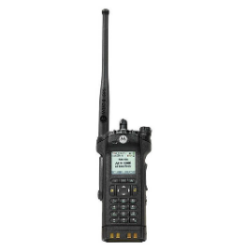
Equipment – 2 radios per VFD
Tri-band portable radio
Programmed to work on the SRS
Compatible with most systems in Nebraska
AES Encryption with Over the Air Rekeying
Over the Air Programming
Desk charger or vehicular charger
Two batteries

Slide 21
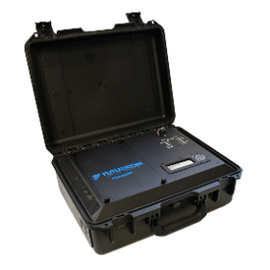
Equipment
Mobile Radio connected to
Vehicle Range Extender (VRX)
Programmed to work on the SRS
VRX extends range for portable radio
AES Encryption with Over the Air Rekeying
Over the Air Programming

Slide 22
Grant Funding Usage
The grant will cover equipment, training and 3-year warranty.
Lifetime SRS Fees $1320 per radio will be funded from the grant.
SRS programming and firmware updates will be provided and scheduled by the OCIO for the life of the equipment.
After warranty, the Departments will be responsible for repair, maintenance.
Consumable items (i.e., batteries, etc.) will not be covered by the grant beyond what is initially received.

Slide 23
Timeline
9/30/23 – VFD application submission deadline.
SRS will sort applications by troop areas and determine the percentage of applications from each troop area.
10/18/23 – OCIO to select recipients using a lottery system
10/31/23 – OCIO to notify grantees of determination.
11/31/23 - Publish training dates for VFDs and schedule installation.
2/20/24 – First training session
Deliver equipment during training session.
Grantee’s monthly test participation is expected from this point forward.

Slide 24
Fire Mutual Aid
Event F1 – Event F12 have been designated for Fire Mutual Aid response
These are assigned as follows:
Troop Area A – Event F1 and Event F2
Troop Area B – Event F3 and Event F4
Troop Area C – Event F5 and Event F6
Troop Area D – Event F7 and Event F8
Troop Area E – Event F9 and Event F10
Troop Area H – Event F11 and Event F12

Slide 25
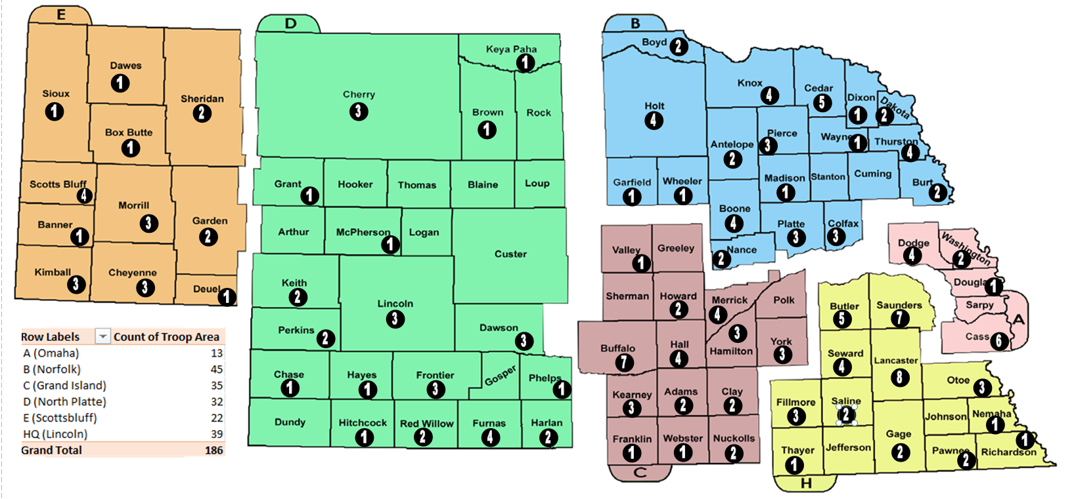
Radio Distribution

Slide 26
Where to go for Information
OCIO - Innovation in Technology : VFD Radio Grant Project Information
https://cio.nebraska.gov/network-serv/publicsafety/VFD/index.html
Training Calendar and sign-up
https://vfdradiogrant.nebraska.gov/trainingregistration
SRS VFD Training Videos
Motorola - https://www.youtube.com/watch?v=XOs49gvKJk0
Kenwood - https://www.youtube.com/watch?v=SM-rpKU4B_8

Slide 27
Communications
Information will be disseminated through the Nebraska State Volunteer Firefighter Association (NSVA) and SRS System Users Group.
Email questions to:
Kelsey C. Hetrick - Systems Coordinator
Office: 402-471-0209 or kelsey.c.hetrick@nebraska.gov

Slide 28
Questions????

Slide 29
Legislation

Slide 30
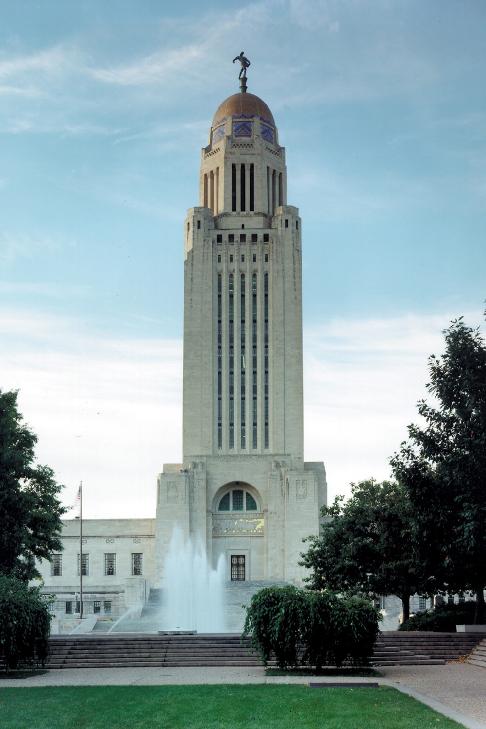
2024 Legislation
LB 646 – Proposed Surcharge Increase
LB 929 - Develop 911 and 988 Standards
LB 1255 – OSP Connections to NG 911 System
LB 1256 – 911 Investigations
LB 1257 - Placeholder
LB 1339 – School Safety and Mapping
LB 1378 – Transfer of Funds
LB 1417 – Eliminate the Enhanced 911 Wireless Advisory Board

Slide 31
Member Comments

Slide 32
Public Comments

Slide 33
Scheduling of next SSAC meeting

Slide 34
Adjourn

