Slide 1
Nebraska Capital Projects Fund (CPF) Project Completion and Reimbursement Guidance

Slide 2
Agenda
Welcome
Subrecipient Quarterly Report
Reminders of Requirements Within the CPF Subaward Grant Attestation and Agreement
Understanding Eligible Expenses for Reimbursement
Guide to Completing the Reimbursement Template
Close-out Report Process

Slide 3
Definitions
Federal Awarding Agency is the Department of Treasury
Recipient is the Nebraska Public Service Commission (the Commission)
Subrecipient are the entities awarded CPF funds via Commission order. Subrecipients are also referred to in the Code of Federal Regulations as non-federal entities
Notes:
Definitions to be familiar with as you navigate participating in this grant opportunity.

Slide 4
The Broadband Programs Reimbursement Template is designed to be used by all entities that receive funding through the Commission (NUSF, NBBP, CPF). Throughout this presentation, we may use the terms "Subrecipient," "Subgrantee," "Grantee," and "Awardee" interchangeably to denote the entity awarded funds to undertake a broadband deployment support project.
Notes:
For CPF, the legal term is Subrecipient.

Slide 5
Subrecipient Quarterly Report
Notes:
We are going to briefly discuss how to correctly report your project as “complete” on the Subrecipient Quarterly Report.

Slide 6
Subrecipient Quarterly Report
Notes:
Do report the Actual Construction Completion date on the Subrecipient Quarterly Report, Item Number 31.

Slide 7
Subrecipient Quarterly Report
Notes:
Specifically, we are talking about #26 – Has the subrecipient initiated work necessary to complete the approved project?
There are two different “project completions”. What is reported to the Commission, per the process outlined in the CPF-1 order (6/27/2023). And what is reported via the Subrecipient Quarterly Report.

Slide 8
Certification of Project Completion
Certification of Project Completion: Subrecipients should submit a Certification of Project Completion to the Commission only once the following conditions have been met:
The entire project area has been constructed as planned and awarded, with every Broadband Serviceable Location (BSL) within the project area having been passed and capable of being served at the required speeds. A BSL is defined by the Federal Communications Commission as “a business or residential location in the United States at which fixed broadband service is, or can be, installed”.

Slide 9
Certification of Project Completion (cont’d)
Additionally, one of the following conditions have been met:
The project has already incurred obligations that meet or exceed the total project costs as submitted with the application approved by the Commission; or
The deployment deadline (end of the performance period) has been reached.
The Certification of Project Completion form is a Commission document and is not reported through the Quarterly Report filed by the Commission with the Department of Treasury.

Slide 10
Project Status – Quarterly Report
Project Completion for purposes of the Quarterly Report will not be the same date as reported to the Commission on the Certification of Project Completion form.
In order for the project status on the Quarterly Report to be “completed” the following conditions must be met:
Certification of Project Completion submitted to the Commission
Speed Testing completed and submitted to the Commission
Reimbursement Request submitted to the Commission and processed by the Commission.

Slide 11
Project Status – Quarterly Report
How to report status of project on the Quarterly Report:
Once the Certification of Project Completion has been submitted to the Commission, please report project as 93% complete.
Once Speed Testing has been submitted to the Commission, please report project as 95% complete.
Once the Reimbursement Request has been submitted to the Commission, please report project as 97% complete.
Only report project as “completed” on the quarterly report once the Commission has completed it’s review of the Reimbursement Request. Use the date the Commission notifies you of final reimbursement as the “completion” date on the Quarterly Report.
Notes:
Notification of final reimbursement does not mean actual receipt of the funds from the Commission. It means the Commission has provided notification of its final determination of the total actual allowable project cost, total grantee cost (match) and total grant funding and the amount of final disbursement.

Slide 12
Reminders of Requirements Within the CPF Subaward Grant Attestation and Agreement
Notes:
As we are half way through the performance period for the first round on CPF, and we understand from the Quarterly Reports that most Subrecipients will begin construction between March and June this year, we wanted to take this opportunity to remind Subrecipients of some of the requirements contained in the Subaward Grant Attestation and Agreement.

Slide 13
Grant Reimbursement
CPF Subaward Grant Attestation and Agreement Section 7
Subrecipient certifies that it will only seek reimbursement for eligible costs under the Grant Award
To the extent applicable, in addition to any other terms, conditions, restrictions, or limitations applicable to eligible costs or reimbursable expenses established by the Commission, costs or expenses charged, paid, or reimbursed under the Grant Award shall be determined as allowable under the cost principles detailed in 2 CFR 200 Subpart E – Cost Principles
Notes:
Throughout this webinar, we will delve into the content of Section 7 of the Subaward Attestation and Agreement. Subrecipients should bear in mind that the Capital Projects Fund operates strictly on a grant reimbursement basis. Therefore, only eligible project expenses that have been incurred and paid are eligible for reimbursement. Certain expenses may pose challenges in terms of adequate documentation. For example, labor reporting and in-house construction expenses are discussed later in the presentation. Should Subrecipients encounter difficulties in adequately documenting any expense, including those not specifically addressed, we encourage you to reach out to the Commission promptly.

Slide 14
Conflicts of Interest
CPF Subaward Grant Attestation and Agreement Section 13
Subrecipient understands and agrees it must maintain a conflict of interest policy consistent with 2 C.F.R. § 200.318(c) and that such conflict of interest policy is applicable to each activity funded under this Grant Award. Subrecipient must disclose in writing to the Commission or Treasury, as appropriate, any potential conflict of interest affecting the awarded funds in accordance with 2 C.F.R. § 200.112.
Notes:
Federal rules require that if there is a conflict of interest (Party A has an interest in Company A (subrecipient) and Company B (contractor to subrecipient) that conflict of interest must be documented and the Commission MUST be notified in writing. Do not wait to disclose the conflict! Disclose the conflict immediately or there could be an adverse impact on your project(s), to include the related expenses determined to be not allowable for reimbursement. Even if you have reason to believe the Commission is aware of the conflict, the Subrecipient MUST still disclose the conflict of interest, in writing, to the Commission. If you need to disclose a conflict of interest, please contact the Commission at psc.broadband@nebraska.gov to get information on how to appropriately disclose the conflict.

Slide 15
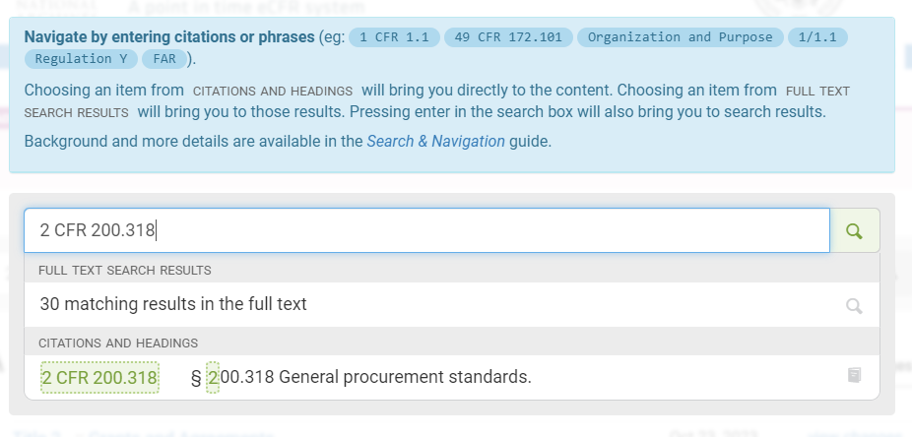
www.ecfr.gov
Notes:
It’s easy to look up the federal regulations. Go to the website shown, enter the regulation number and hit “enter”. The regulation will appear in the results section, click on the code and you can read the entirety of the rule.

Slide 16
Compliance with Applicable Laws
CPF Subaward Attestation and Agreement Section 14(2)(d)
These audit requirements do not generally apply to for-profit business; however, the Commission remains responsible for ensuring compliance with Treasury requirements through the implementation of audit and monitoring controls pursuant to 2 C.F.R. 200.501(h). Accordingly, the requirements of this Section shall apply to Subrecipients and Subrecipient’s Contractors. Subrecipients shall require and cause any Subrecipient Contractor or subgrantee or subrecipient used by Subrecipient in connection with the Grant Award to agree to and be subject to and bound by such terms.
Notes:
The following is only a few of the many requirements listed in this section of the Attestation and Agreement.

Slide 17
Compliance with Applicable Laws (cont’d)
CPF Subaward Attestation and Agreement Section 14(3)
Subpart (c) states that Subrecipients are required to develop appropriate internal control procedures consistent with 2 C.F.R. § 200.303.
Subpart (h) requires compliance with New Restrictions on Lobbying, 31 C.F.R. Part 21. Subrecipients must include the required language in any and all contracts that utilize federal funds.
Subpart (l) requires compliance with all contract provisions for non-federal entity (Subrecipient) contracts under federal awards under Appendix II, 2 C.F.R. Part 200.
Notes:
The following is only a few of the many requirements listed in this section of the Attestation and Agreement.

Slide 18
Compliance with Applicable Laws (cont’d)
CPF Subaward Attestation and Agreement Section 14(10)
In the event of Subrecipient’s noncompliance with section 604 of the Act, or any other applicable laws, Treasury’s implementing regulations, guidance or any reporting or any other program requirements, Treasury and the Commission may impose additional conditions on the receipt of grant reimbursement or any future grant funding, if any, or take any other available remedies as set forth in 2 C.F.R. § 200.339. Funding provided may be subject to recoupment, in whole or in part and any additional payments may be subject to withholding.
Notes:
The following is only a few of the many requirements listed in this section of the Attestation and Agreement.

Slide 19
What is an Eligible Expense for Reimbursement

Slide 20
What is an Eligible Expense for Reimbursement
The Commission is obligated to confirm whether Subrecipients expended funds for the purpose of the grant and only on expenses that are:
Allowable
Necessary
Reasonable
Allocable
Adequately Documented

Slide 21
Allowable and Necessary
Be necessary and reasonable for the performance of the Federal award and be allocable thereto under these principles;
Conform to any limitations or exclusions set forth under the cost principles detailed in 2 CFR 200 Subpart E or in the Federal or State award as to types or amount of cost items;
Be consistent with policies and procedures that apply uniformly to both federally-financed and other activities of the non-Federal entity;
Be accorded consistent treatment. A cost may not be assigned to a Federal award as a direct cost if any other cost incurred for the same purpose in like circumstances as been allocated to the Federal award as an indirect cost;
Be determined in accordance with generally accepted accounting principles (GAAP), except, for state and local governments and Indian tribes only, as otherwise provided for this in part.
Notes:
The non-federal entity is the Subrecipient.

Slide 22
Allowable and Necessary (cont’d)
Not be a cost or used to meet cost sharing or matching requirements of any other federally-financed program in either the current or a prior period;
Be adequately documented;
Cost must be incurred during the approved budget period. The federal awarding agency is authorized, at its discretion, to waive prior written approvals to carry forward unobligated balances to subsequent budget periods.
Note: For purposes of CPF, materials and goods (physical assets) such as fiber, conduit, equipment, etc. purchased prior to the Award but installed after the Award, may be eligible for reimbursement if adequately documented, necessary, allocable and reasonable. Contact the Commission at psc.broadband@nebraska.gov if there are any questions about the eligibility of inventory on-hand.

Slide 23
Reasonable Costs
A cost is reasonable if, in its nature and amount, it does not exceed that which would be incurred by a prudent person under the circumstances prevailing at the time the decision was made to incur the cost. In determining reasonableness of a given cost, consideration must be given to:
Whether the cost is a type generally recognized as ordinary and necessary for the operation of the non-Federal entity or the proper and efficient performance of the Federal award;
The restraints or requirements imposed by such factors as: sound business practices; arm’s length bargaining; Federal, state, local, tribal and other laws and regulations; and terms and conditions of the Federal award;
Market prices for comparable goods or services in the geographic area;
Whether the individuals concerned acted with prudence in the circumstances considering their responsibilities to the non-Federal entity; its employees, where applicable its students or membership, the public at large, and the Federal Government.
Whether the non-Federal entity significantly deviates from its established practices and policies regarding the incurrence of costs, which may unjustifiably increase the Federal award’s cost.
Notes:
An Arms Length Transaction is an expression which is commonly used to refer to transactions in which two or more unrelated and unaffiliated parties agree to do business, acting independently and in their self-interest.
If a transaction utilizing CPF funding is not an arms length transaction, the Subrecipient should review the Conflict of Interest rule on slide 6. Document and notify the Commission. Approval of the transaction is required in situations where there is a conflict of interest and the transaction was not done at an arms length.

Slide 24
Allocable Cost
A cost is allocable to a particular Federal award or other cost objective if the goods or services involved are chargeable or assignable to that Federal award or cost objective in accordance with relative benefits received. This standard is met if the cost:
Is incurred specifically for the Federal award;
Benefits both the Federal award and other work of the non-Federal entity and can be distributed in proportions that may be approximated using reasonable methods; and
Is necessary to the overall operation of the non-Federal entity and is assignable in part to the Federal award in accordance with the principles in this subpart.

Slide 25
Adequate Documentation
Adequate documentation is very important for the Commission to determine if the expense is eligible for CPF reimbursement. This standard is met if the expense:
Is a direct cost for the purposes of deploying the approved broadband project;
Documentation includes, but is not limited to, contract, purchase orders, work orders, invoices, and proof of payment is provided to the Commission upon a reimbursement request; and
Is supported by any other supplemental documentation requested by, and required to, allow the Commission to determine if the expense is eligible for reimbursement.

Slide 26
Completing the Reimbursement Template

Slide 27
Nebraska Broadband Programs Reimbursement Template
Standardized document for all Subrecipients to utilize when submitting reimbursement requests to the Commission.
Review Capital Projects Fund Reimbursement Guide. We recommend that the guide is reviewed by all personnel directly working on the approved project, but especially those that handle contracts, purchase orders, work orders, invoices, and payment of obligations.
Budget Categories should be reviewed. These are the drop downs available in the reimbursement template.

Slide 28
Nebraska Broadband Programs Reimbursement Template
Below are general tabs included in the template that we will overview in the following slides:
Budget Categories
Timesheet Example
Project Expenses
Original Invoice from Vendor
Budget Allocation
Materials/Goods Used for Broadband Deployment
Labor Reporting

Slide 29
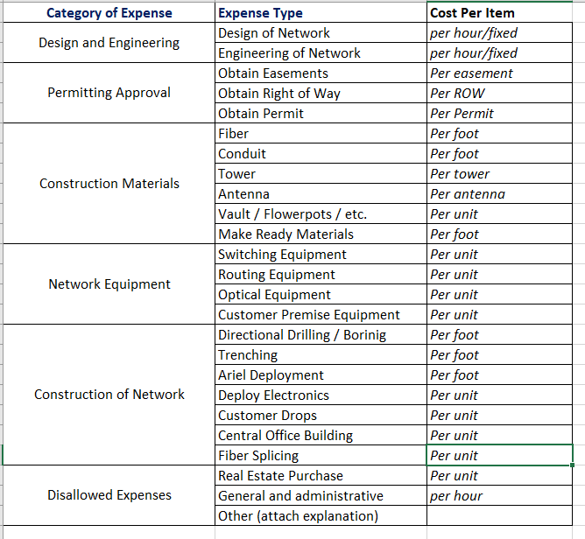
Notes:
Two new expense types have been added since the Budget Template was put out for comment in the 2024 Bridge round. For Construction of Network, we have added an expense type for Central Office Building and Fiber Splicing.

Slide 30
1. Project Expenses
Notes:
In Section I: Summary of Project Expenses ……
Period of Performance: the date of the Award – June 27, 2023. The end date of the Period of Performance is equal to the day that the project is certified as complete OR the last day of the allowed project build period (December 27, 2024). In this example, the period of performance is June 27, 2023 to December 1, 2024 (date the project was certified as complete).
Subrecipient should enter the approved APPLICATION project cost (what did you say the project was going to cost). Awardee Match Requirement is the total amount that you said you would pay for the project – based on the approved application cost. The Awardee % is the percentage amount you agreed to pay. Grant Funding Awarded is the amount the Commission awarded for the project. The Grantor % is the percentage amount the Commission agreed to pay for the approved project.

Slide 31
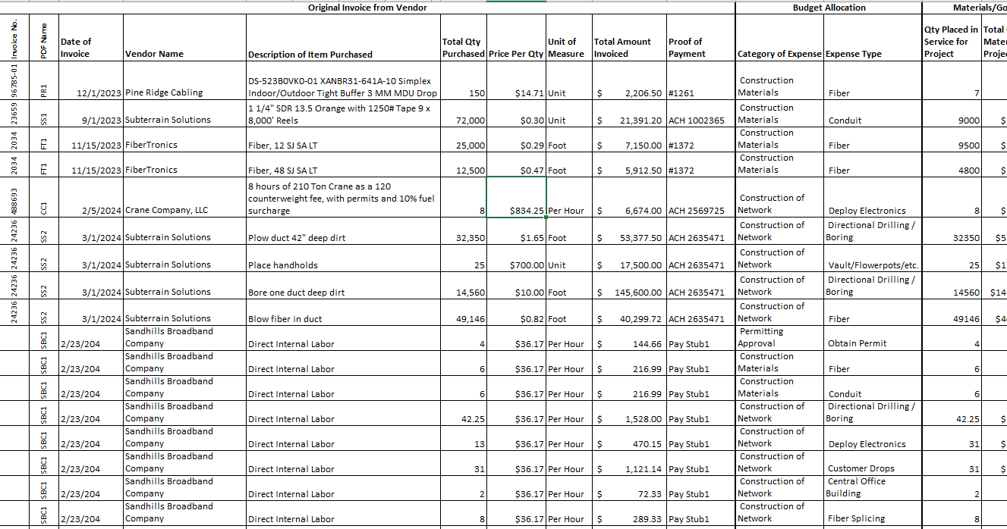
Notes:
This is an example of a completed Project Expenses summary that includes examples of data that the Subrecipient will enter to submit the costs obligated and expended for the approved project during the performance period. There are three main sections. First, the Original Invoice from Vendor. Second, the Budget Allocation, and last the Materials/Goods Used for Broadband Deployments. Let’s take these one section at a time.

Slide 32
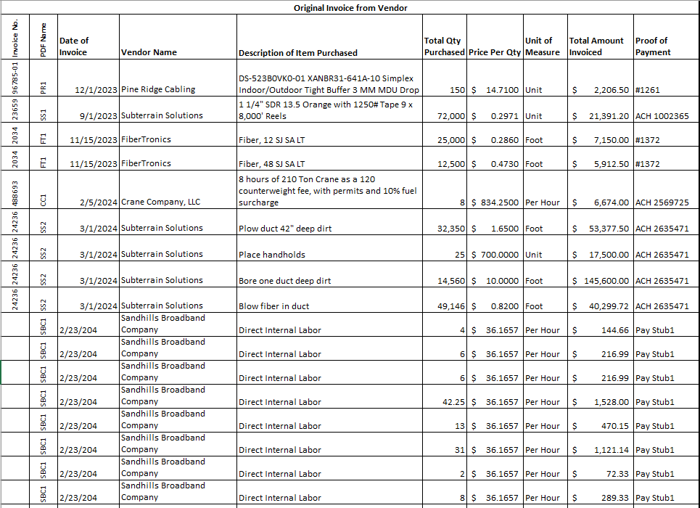
Original Invoice from Vendor
Notes:
You will be entering the data directly from the Vendor invoice. And we have some examples to show you for how to submit the actual vendor invoice. For purposes of entering the data into the reimbursement template, we need to know what the vendor actually invoiced you, the Subrecipient.
Let’s look at the first line. Invoice No. comes directly from the vendor invoice. PDF Name is the name of the PDF file that you submit to us.
Description of Item Purchased – this should be directly from the vendor invoice. Total Qty Purchased should also be exactly what it shows on the vendor invoice – even if not the entire amount is used for the approved project. Price Per Qty – this should include the cost per unit/foot + any shipping or freight expense allocated based on total net charged on the invoice. Proof of payment – This could be a check number, ACH transaction number. We don’t show it here, but if you are using a credit card Visa 6347 (last four digits) is appropriate.

Slide 33
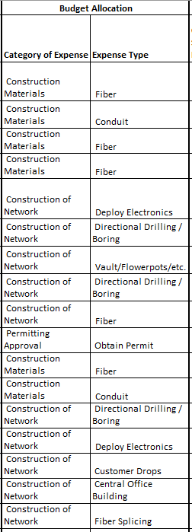
Budget Allocation (dropdown only)
Notes:
Use the Budget Categories tab to help. Choose the appropriate Category of Expense. And then choose the appropriate Expense Type. The Expense Type’s are general in nature. Use your discretion and choose what best defines the purpose of the expenditure. Use Edit PDF function to add information directly to the vendor invoice to provide additional context when you feel it is appropriate. More information is always better than less information. And will help us to process the request for reimbursement quicker.

Slide 34
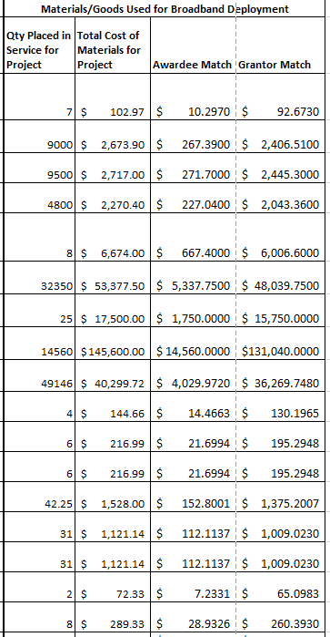
Materials/Goods Used for Broadband Deployment
Notes:
This section is where you tell us the Qty Placed in Service for the Project. Remember the first line item had 150 qty purchased in total. But for this CPF approved project, you utilized only 7 items. All other fields will auto populate. Do not over-write the formulas in these fields.

Slide 35
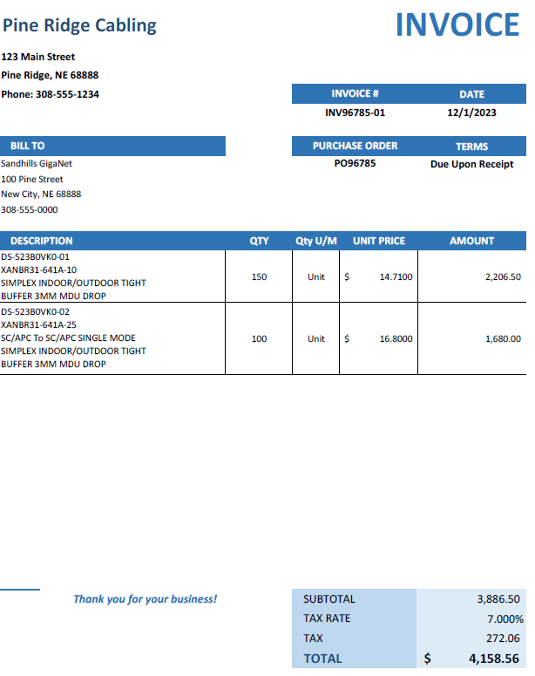
Example of a Vendor invoice.
Subrecipients can submit invoices with no markings or notations.
Utilizing Adobe PDF Edit Tools or handwritten notations can provide clarity and therefore greatly streamline the Commission staff review.

Slide 36
Notes:
We are going to focus on this very first line of the Reimbursement Template. Notice there is only ONE line item on the reimbursement template. Notice that the original invoice has a quantity of 150. But the Materials/Goods Used for Broadband Deployment has a quantity of 7. Now, let’s look at a different way to submit the Vendor invoice to the Commission.

Slide 37
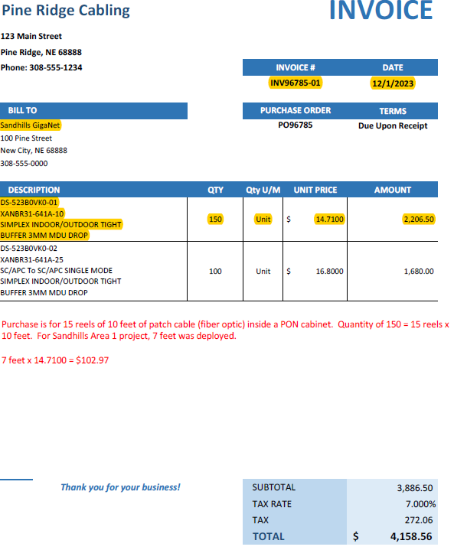
Utilize the highlighter function in Adobe to highlight the Invoice Number, Date, the Payor and the line item(s) on the bill associated with the approved project.
Tell us what we need to know about this transaction.
Helps you in case of a future audit.
Helps us process your reimbursement more efficiently.
Notes:
A few things. Highlighting is VERY helpful. Draw our attention to what we need to note on the invoice. The more time we spend trying to interpret the Vendor Invoice and the data on the reimbursement template makes it more likely your reimbursement request will be delayed. The more questions we have, the longer it takes to process the reimbursement request. Get ahead of the questions and tell us what we need to know. Highlight – Invoice #, Date of Invoice, Payor, line item or items directly associated with the project. In this case, only the first line on the invoice is for Sandhills Area 1 project. Use the Edit feature to “add text box”. Change font to RED and interpret the invoice – What was purchased, calculation for unit of measure (total) and then calculate what was actually used for the project. This should match what is on the reimbursement template.

Slide 38
Notes:
Two line items on the Vendor Invoice. Two line items on the reimbursement template.

Slide 39
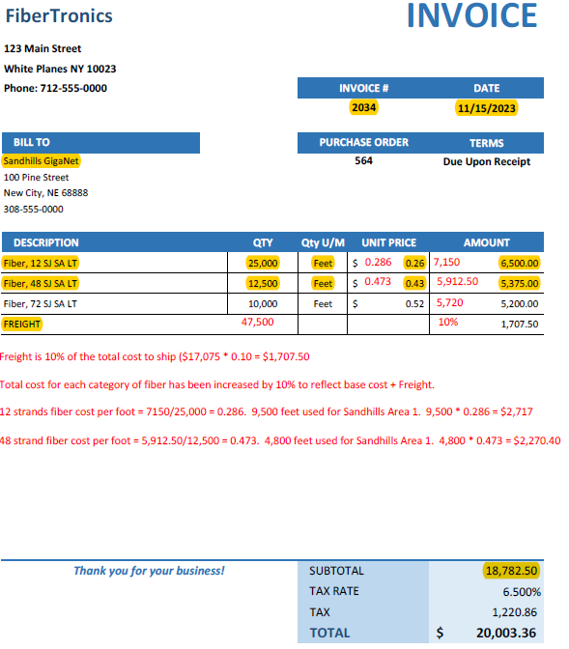
Notes:
Freight is eligible for reimbursement. Sales Tax is not. Notice what is highlighted. When preparing the Vendor invoices to the Commission bear in mind a few things. The Audit period is five years after close-out (Commission final payment for the project). Which means 6-7 years from now a federal government employee (Treasury, OMB, Inspector General, etc.) is going to potentially be looking at the data submitted to verify the expenditures related to your project. For the benefit of the entity it is in your best interest to spell everything out. Tell the story about THIS invoice and its relation to the approved project. Jane in accounting knows everything about this invoice in 2024. Jane may be unavailable when the auditor comes knocking. You don’t want to be in a position of trying to figure out the specifics of any of the Vendor Invoices 6-7 years later.
In addition, by proactively telling us directly on the invoice exactly how the price per unit was calculated, the Commission can verify the math and more efficiently (and quickly) process the request for reimbursement. If the price per unit does not match what is on the Reimbursement template, and we have to figure out how the price per unit was calculated, it will delay your reimbursement request.
More immediately though, providing Commission staff the information as shown in this example when submitting your Vendor Invoices is going to greatly increase the efficiency of staff review, reduce the number of emails from staff asking questions, etc. If there are too many questions to process your reimbursement timely (30-60 days) it could take several months until we have adequate documentation necessary to process your reimbursement request.

Slide 40
2. Labor Reporting
Only for Direct Internal Labor
Subrecipient must have internal controls in place to adequately document and track employee time spent directly on the approved project.
Only employee time spent directly on the approved project – the actual deployment of the network and connecting customers is eligible for reimbursement.
General administrative expenses are not eligible for reimbursement (accounting, human resources, legal, regulatory compliance, CEO, COO, CFO, CTO, etc.).
Notes:
The Subrecipient must have an internal means of tracking how much time employees are spending on the project vs. non-project related activities.

Slide 41
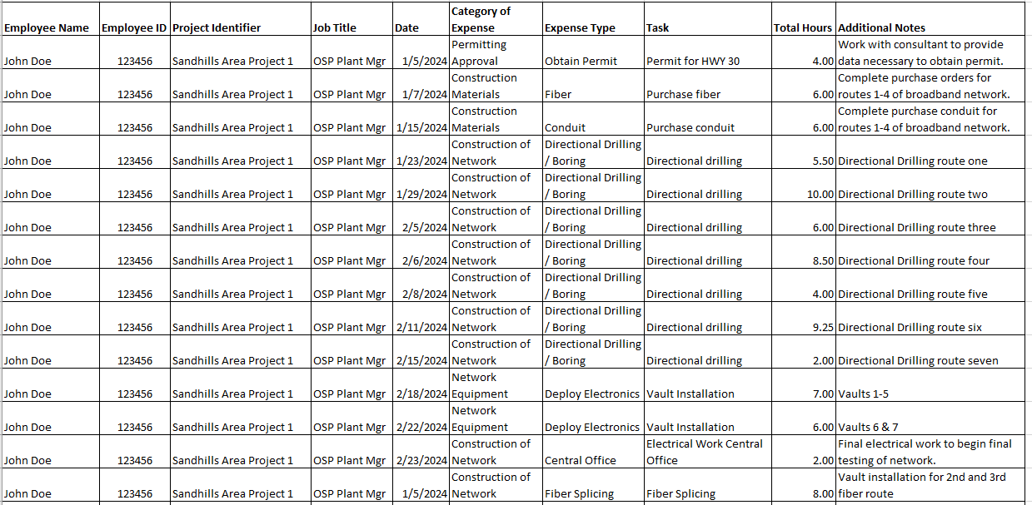
Notes:
The Reimbursement template contains a “Time Sheet Example” tab. You can utilize this to record the time. Or you can provide documentation directly from your internal tracking system. Documentation must include the same information collected on the “Time Sheet Example” at a minimum. Contact the Commission to discuss how to adequately document internal direct labor.

Slide 42
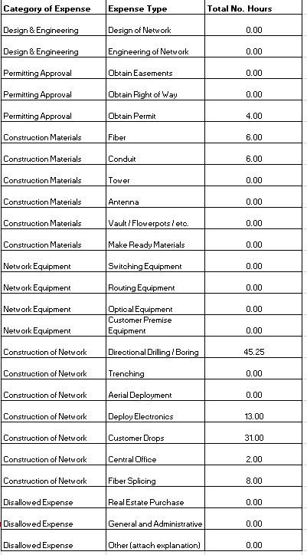
Notes:
On the Time Sheet Example, there is a requirement to enter the Category of Expense and Expense Type. We do need data, even internal expenses, to be tracked by expense type. Columns L, M and N will automatically calculate the number of hours for each category of expense and expense type for the Employee. Remember: Each employee should have its own separate time sheet.

Slide 43
Notes:
If requesting reimbursement for direct internal labor, Section 2 must be completed.

Slide 44
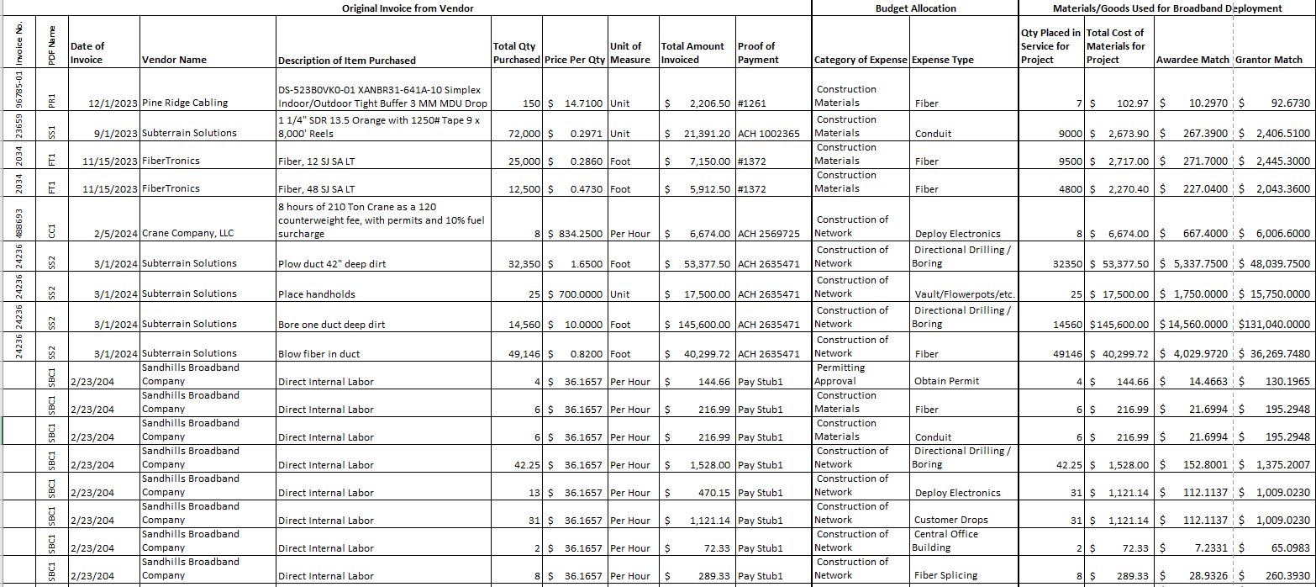
Notes:
Once Section 2. Labor Reporting is complete, enter the respective data in Section 1. Project Expense. If the Budget Allocation is different, (engineering, directional drilling, customer drops, etc.) then the labor should be reported on separate line items based on the Budget Allocation.

Slide 45
2. Labor Reporting
There should be adequate documentation to verify the direct internal labor expenses. Be sure your internal controls are tracking time at the project level.
The Commission will need documentation to verify the hourly wage of each employee. One pay stub during the time the employee worked on the project must be submitted along with the reimbursement request.
System generated payroll reporting that includes wage information would also be adequate documentation.
Keep in mind the audit period and maintain all records accordingly.

Slide 46
In-House Construction Reporting
Subrecipients that choose to perform any in-house construction must have internal controls to document costs such as equipment, machinery and vehicle usage.
Subrecipients that plan to request reimbursement for usage of internal equipment, machinery, or vehicles must notify the Commission and provide an explanation of cost methodology and a proposal for how to provide adequate documentation that shows the cost is reasonable and necessary for the deployment of the broadband project. Such proposal should be submitted to the Commission for consideration as early as possible.
Subrecipients that allocate costs of equipment, machinery and vehicles to projects in their normal accounting process through use of loading or clearing accounts can provide an example of the cost allocation methodology with their proposal.
Notes:
We recognize that accounting practices may differ from company to company due to a variety of factors such as the company's size, internal processes, and systems, and that these inherent differences can lead to variations in how expenses are categorized, documented, and reported internally. Therefore, we request that companies utilizing such cost allocation processes provide an explanation of their methodology to the Commission for consideration as early as possible.

Slide 47
Project Close-out Report
Notes:
The following information provided as a reminder of the language of the Attestation and Agreement, section 8(4). The following is the exact language in the Attestation and Agreement.

Slide 48
Project Close-Out Report
No later than sixty (60) days following completion of the Project or termination of the Grant Award or expenditure of all award funds, whichever occurs later, Subrecipient shall file, on forms prescribed by the Commission, a Close-out Report which addresses the following:
A description of the accomplishments of the objectives set forth in the Subrecipient’s application;
A description of any problems, delays or adverse conditions that occurred, or which impacted the overall Project objectives, caused any missed deadlines, or precluded the Subrecipient’s ability to achieve the desired outcomes of the Project.

Slide 49
Project Close-Out Report (con’td)
A comparison to how grant funds were spent against the original budget submitted to the Commission and approved in Subrecpient’s application; and
A map indicating that all construction has been completed as proposed in the application. If there was a portion of the proposed project area that was not constructed Subrecipient acknowledges and agrees that the Commission may require a portion of the Grant Award to be rescinded or refunded.
Additionally, as the Close-out Report forms have not been made available to the Commission as of the date of this Attestation and Agreement, the Subrecipient will comply with any request for additional data not specified herein, but which the Commission determines is necessary to comply with Treasury reporting requirements.

Slide 50
Importance of Invoice Accuracy
The CPF Reimbursement Request form has an attestation which states: “By signing this document, I attest under penalty of perjury that the information contained in this form and all supporting documents are true and accurate, and that I have undertaken due diligence to obtain knowledge regarding these claims. I understand that the submission of false information in this document shall be considered as a violation of an order of the Commission, and may be subject to civil and/or criminal penalties”

Slide 51
Importance of Invoice Accuracy
Subrecipients are required to ensure that the invoices produced by their vendors are true and accurate.
Subrecipients are required to perform due diligence to ensure that the invoices it submits to the Commission are in fact true and accurate.
The invoice should clearly convey the following information:
The date of the work performed/materials billed
The item purchased/work performed
Cost per item/total quantity/total net cost
Obtain revised invoices when necessary.

Slide 52
Important Reminders
The Commission retains the right to follow up with communities during project construction.
The Commission retains the right to ask Subrecipients for additional information upon review of the Reimbursement Request.
The Commission is required to regularly monitor Subrecipients. During the performance period, you may be contacted by the Commission Grant Policy Analyst and/or Auditor.
The Commission staff is here to help each Subrecipient be successful!!! Please reach out to staff for assistance for any questions that arise.
Suggestions on what the Commission staff can do and resources we can provide to help Subrecipients be successful, please let us know!

Slide 53
Questions?
We love hearing from you! Please feel free to ask questions at any time. Email your question to our general inbox at psc.broadband@nebraska.gov and someone on our team will get back to you.

